Slide 1
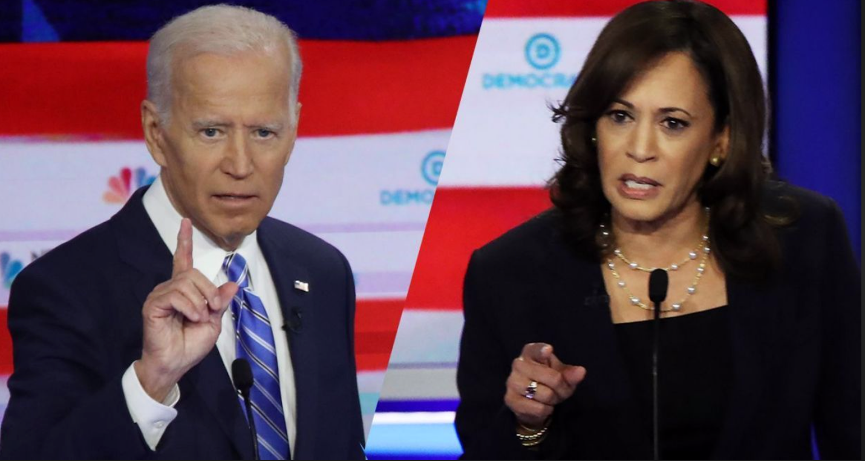
US Election: ‘What If…?’
“Issues Which Keep Me Awake At Night”
30 September 2020
Alastair Newton
Director, Alavan Business Advisory Limited
+260 968095230
adbnewton@gmail.com
Follow Alavan Independent on Facebook

Slide 2
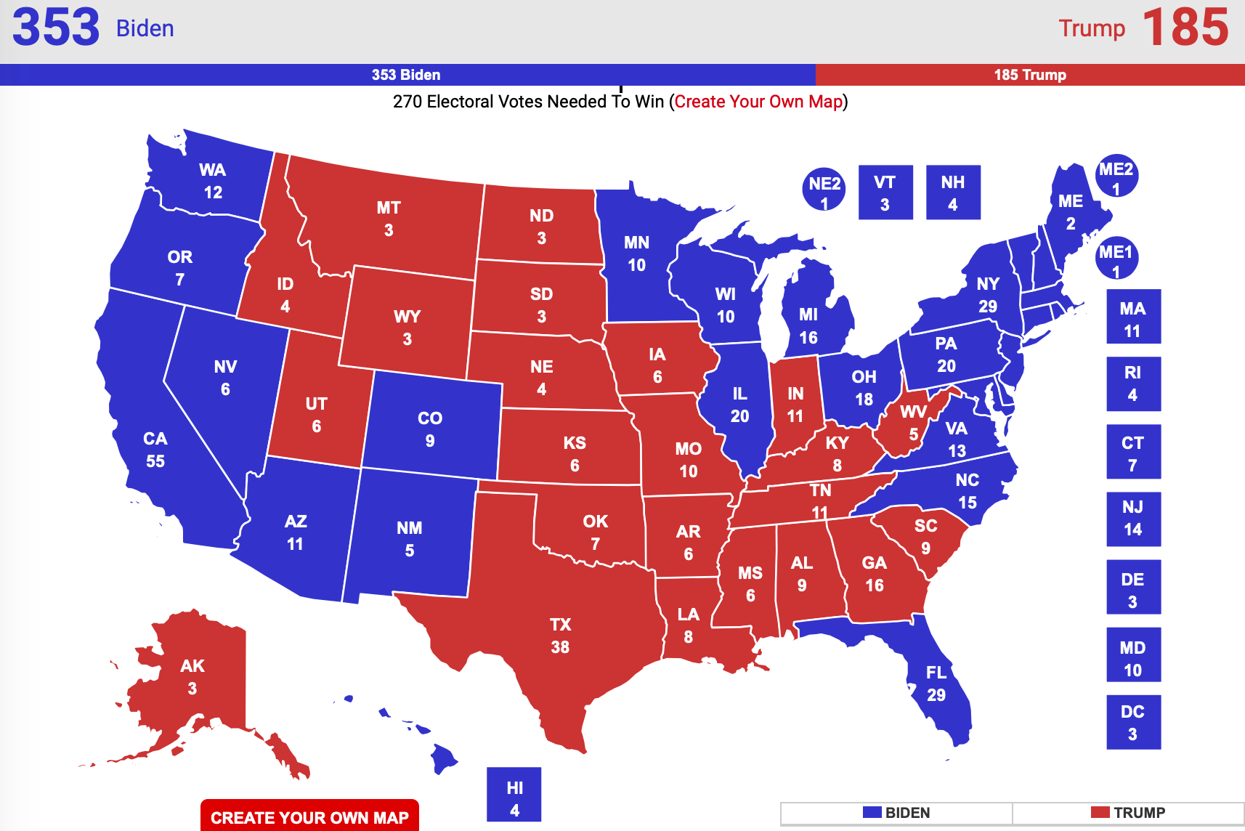
No ‘Slam Dunk’ But…
“From 30,000 feet, the presidential race looks much as it did when we first launched our presidential election forecast in August. Joe Biden has about a 3 in 4 chance of winning compared to President Trump’s roughly 1 in 4 shot….”
Geoffrey Skelley, FiveThirtyEight, 16 September 2020

Slide 3
Supreme Importance
“Memorials and tributes to [Ruth Bader Ginsberg]… threaten to be overshadowed by the political firestorm that her death — and the resulting vacancy on the highest court in the US — will set off.… It’s a thicket of unknowns, but in a race that was tilting toward [Mr] Biden, any change in the existing dynamics is good news for [Mr] Trump.”
Anthony Zurcher, BBC News, 19 September 2020

Slide 4
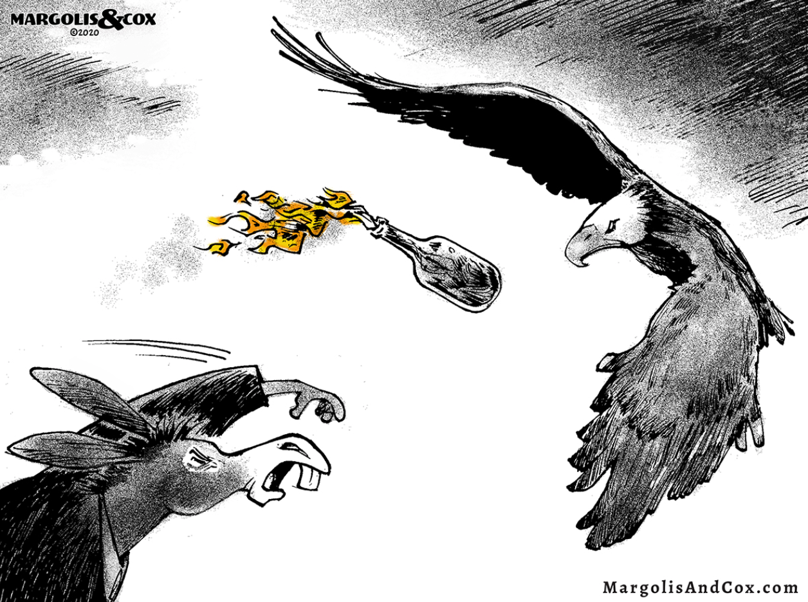
Civil Unrest: Worse To Come
“Donald Trump is deliberately instilling a civil war mentality in the minds of tens of millions of his base”
Henry McLeish, The Scotsman, 27 July 2020

Slide 5
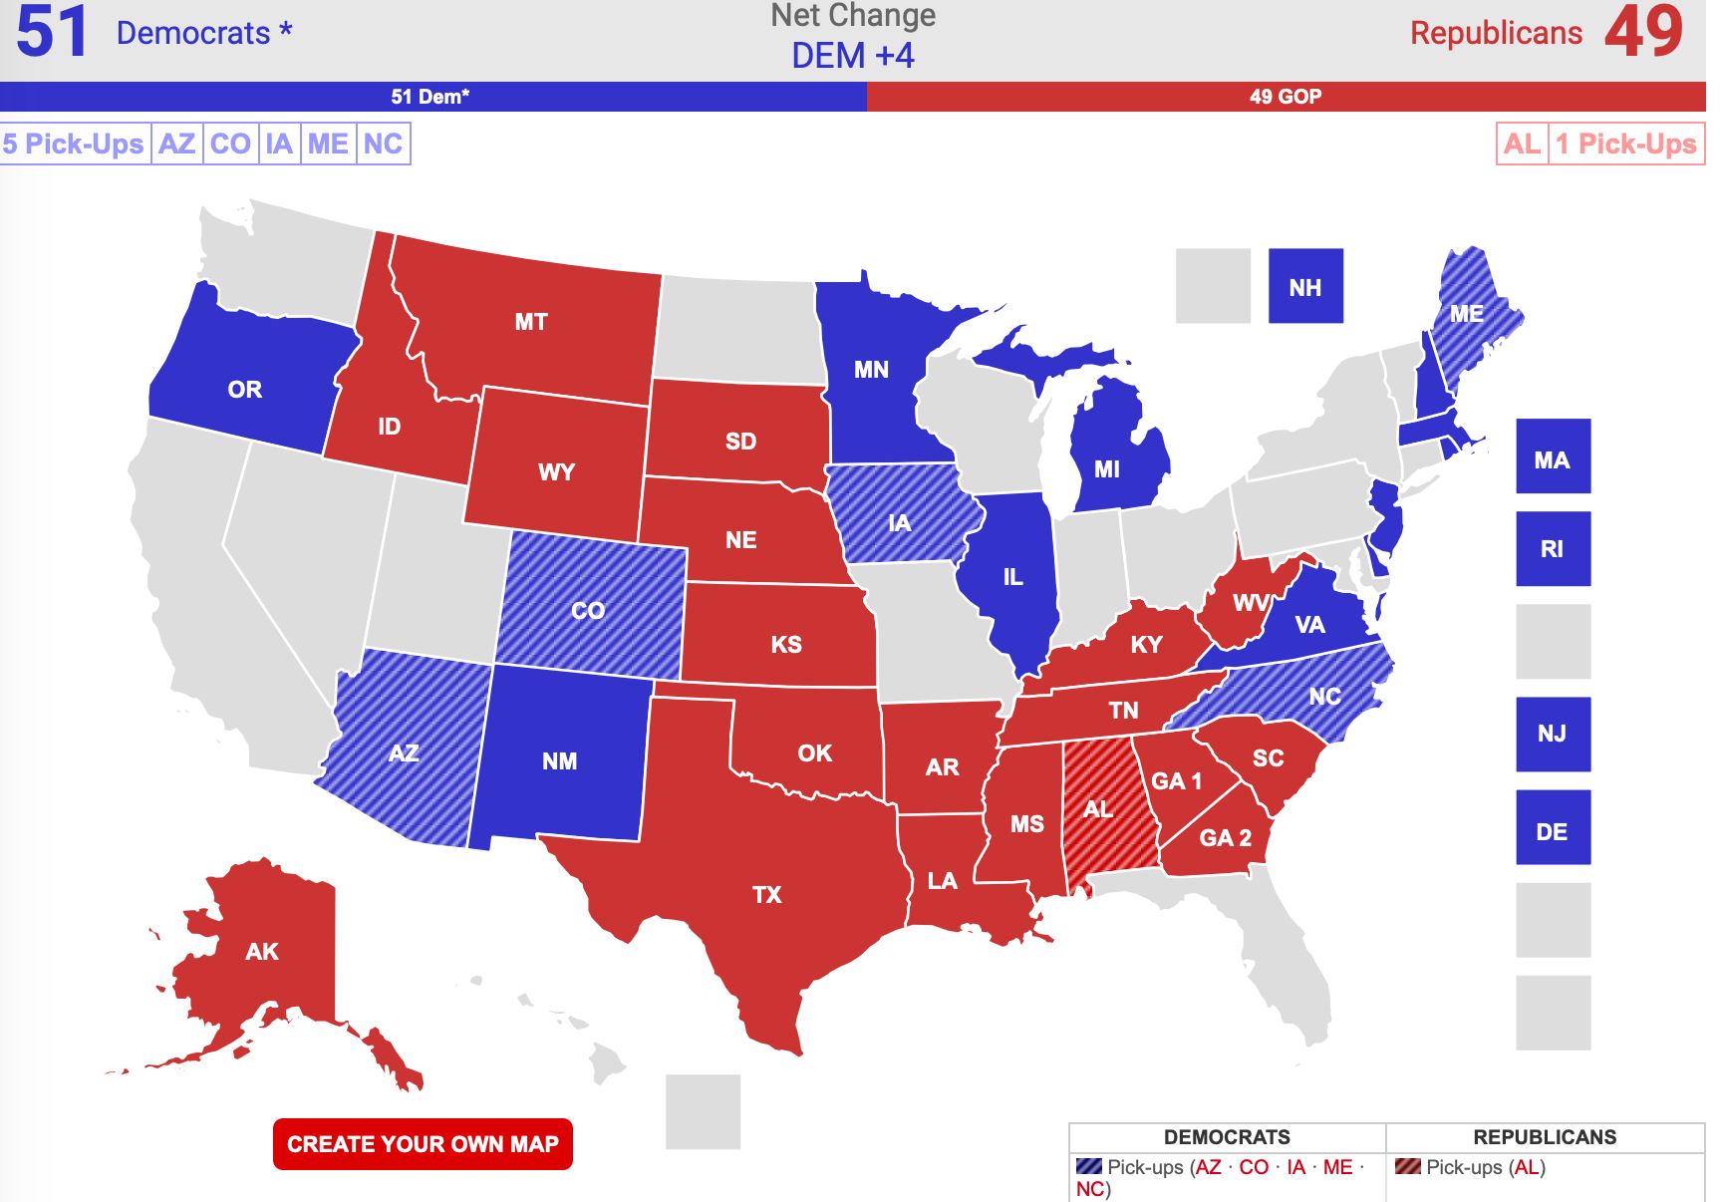
Clean Sweep?
“And the filibuster? Asked whether he supports getting rid of the filibuster, so the Senate could pass bills with a straight majority, [Mr] Biden said: ‘It’s going to depend on how obstreperous they become,’ referring to Republicans. He noted that he has historically supported the filibuster and was optimistic he could find common ground with Republicans. ‘But I think you’re going to just have to take a look at it,’ he added.”
David Leonhardt, The New York Times, 14 July 2020

Slide 6
The Hottest Issue
“…Mr Biden promises to make tackling climate change a priority…. There is no starker contrast between the Republican president and his Democratic challenger than on this issue”
The Economist, 19 August 2020

Slide 7
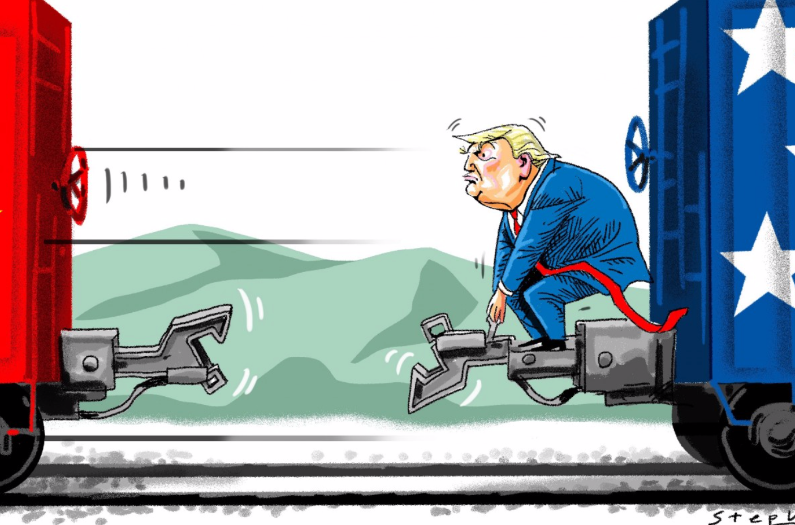
…Global Warming And Deglobalisation
“When I hear global warming, I think jobs.”
Henry Farrell and Abraham L. Newman, Foreign Affairs, January/February 2020

Slide 8
“It’s (Still) The Economy, Stupid!
“The plan punishes American companies that produce products overseas by adding a 28 percent corporate tax rate and an additional 10 percent ‘offshoring penalty surtax’ totaling a 30.8 percent tax rate on profits. To incentivize ‘Made in America’ production, the administration would give companies a 10 percent tax credit on a number of investments like revitalizing closed factories and expanding payrolls.”
Biden-Harris Campaign Press Release, 4 September 2020

Slide 9
Would ‘The Rich’ Be Reconciled…
“I'm not looking to punish anybody, but damn it, it's about time the super wealthy and corporate America start paying their fair share”
Joe Biden, 18 September 2020 (at a campaign rally in Duluth, Minn

Slide 10
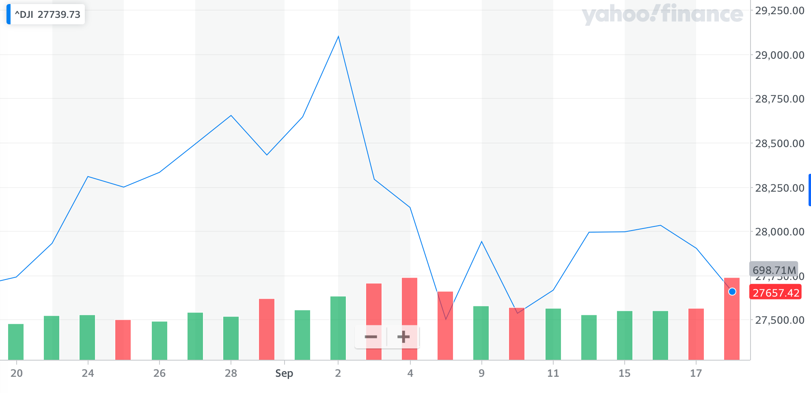
…And How Would Markets React?
“PWBM finds that over the 10-year budget window 2021– 2030, the Biden platform would raise $3.375 trillion in additional tax revenue and increase spending by $5.37 trillion. Including macroeconomic and health effects, by 2050 the Biden platform would decrease the federal debt by 6.1 percent and increase GDP by 0.8 percent relative to current law.”
Penn Wharton Budget Model, September 2020

Slide 11
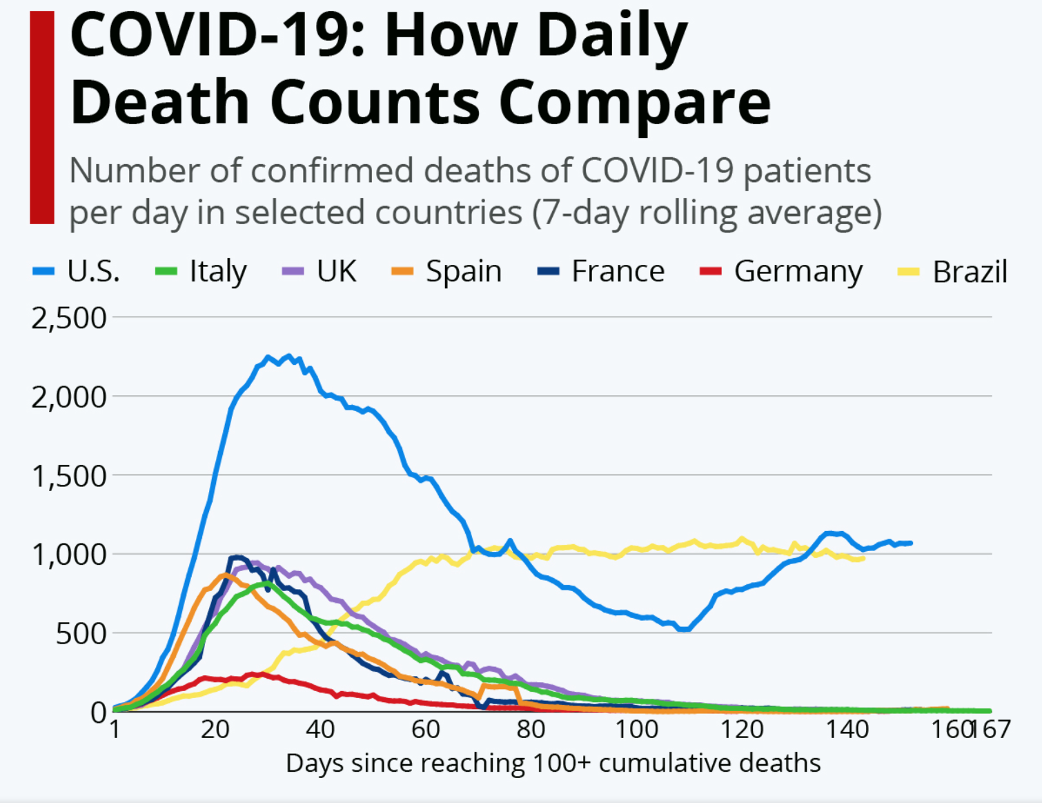
Containing Covid-19?
“As president, Joe Biden will put a plan into effect on day one, develop and deploy rapid test with immediate results. Make sure testing, treatments and ultimately a vaccine reach all Americans, including communities of color who have historically been left behind. Manufacture the medical supplies and protective equipment we need and make them right here in America…”
Kamala Harris (campaign speech), 27 August 2020

Slide 12
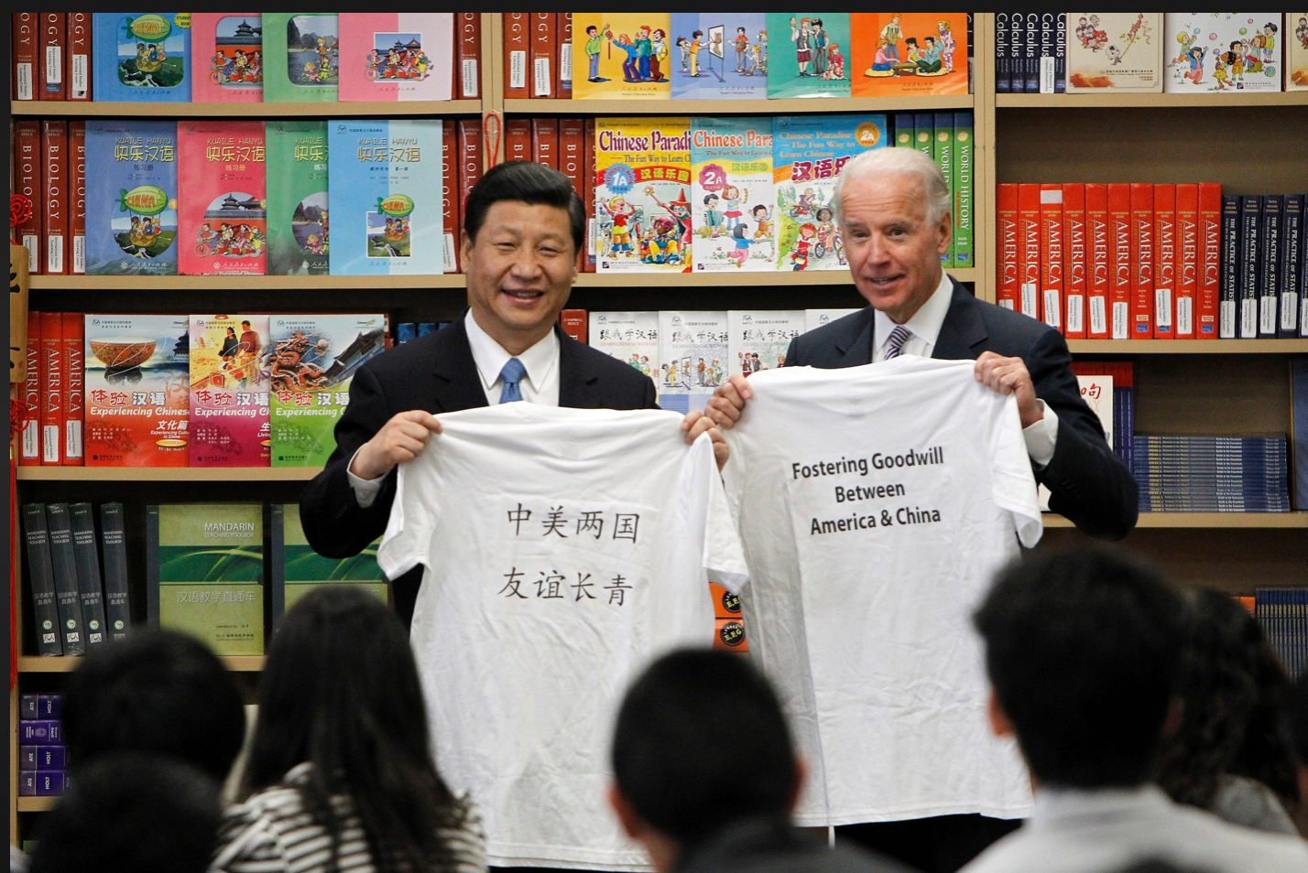
China — Joe’s Long Journey
“If Mr. Biden becomes president, his 40-year association with China will reach a crescendo. Analysts on both sides of the Pacific say greater conflict may be inevitable, given the two nations’ ideological systems, nationalist sentiments and trajectories — one a superpower on the ascent, the other trying to preserve its reach.”
Edward Wong et al, The New York Times, 6 September 2020

Slide 13
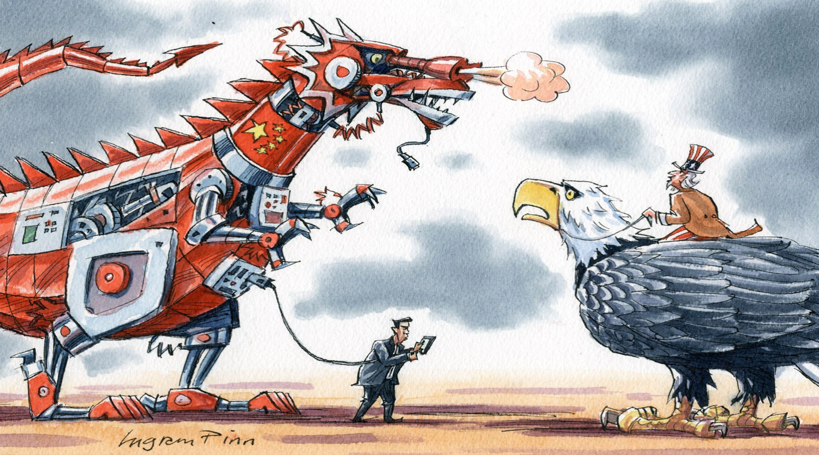
Technology And…
“With the US presidential election fast approaching, experts are debating whether a victory for Democratic nominee Joe Biden in November will reverse a building tech war that threatens to split the global technology industry in half, from semiconductors to the internet itself. The short answer: no…”
Yujie Xue and Celia Chen, South China Morning Post, 16 September 2020

Slide 14
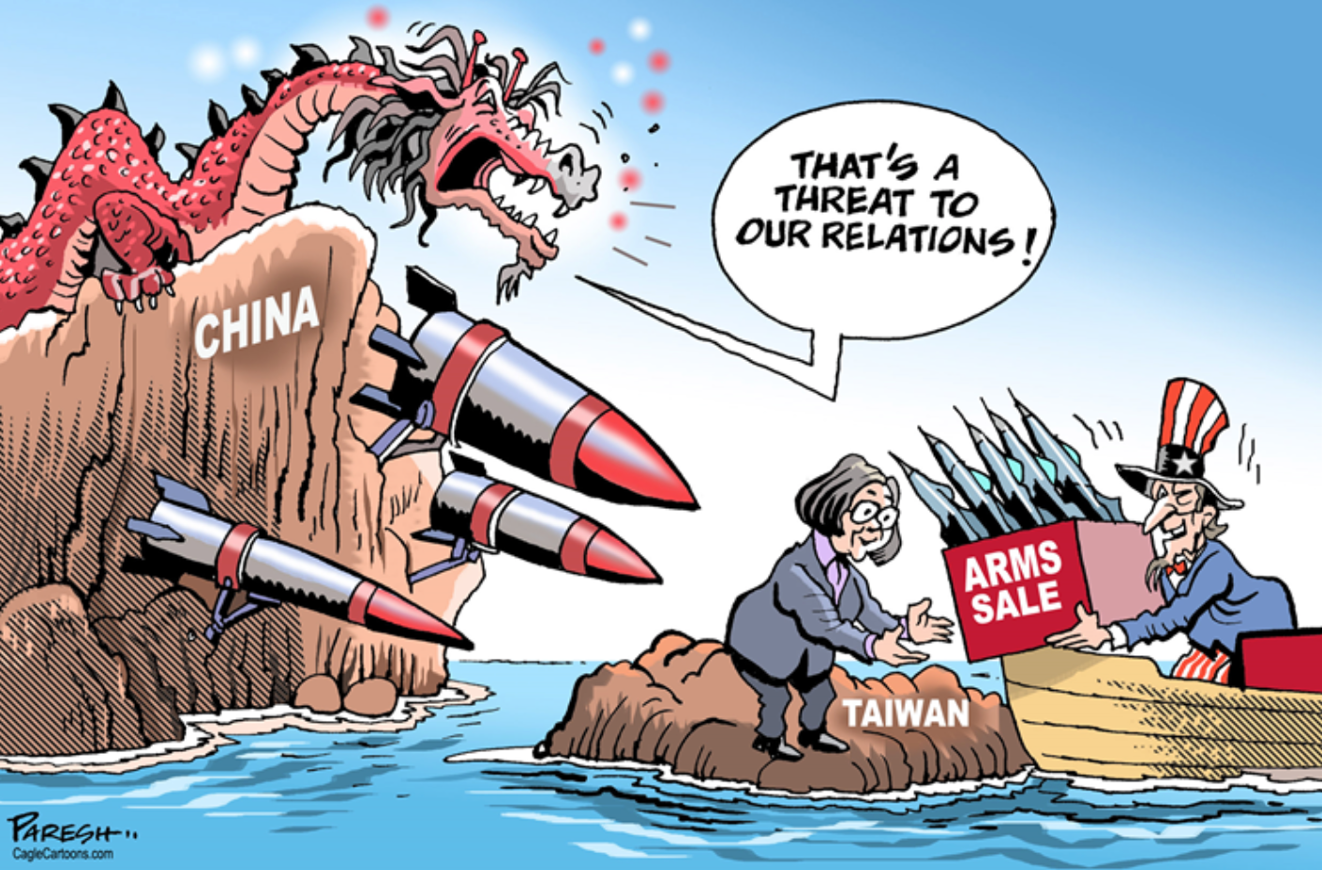
…Taiwan
“[Mr] Biden’s past positions on Taiwan’s status and future may not be encouraging to many Taiwanese. Nevertheless, [Mr] Biden has showed his commitment to the [Taiwan Relations Act] throughout his career with the legislation he introduced or cosponsored.”
Kuang-shun-Yang, The Diplomat, 6 March 2020

Slide 15
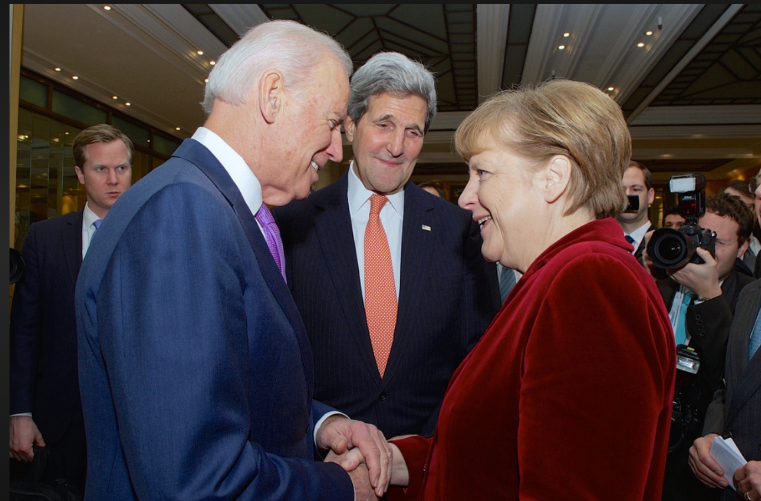
Transatlantic Ties
“While European pundits are correct to doubt the old transatlantic alliance will simply return to its pre-Trump state, they are underestimating what a Biden victory would mean for U.S. foreign policy. The Democratic Party is still a party of values, and a Biden administration would pursue a full reset after…restoring America's historic commitment to responsible leadership on the world stage.”
Alexander Soros, CGTN, 4 July 2020

Slide 16
Old Dog, New Tricks?
“…Mr. Biden’s vision looks less like a better approach to foreign policy and more like a rerun. As Paul Musgrave, a political scientist at the University of Massachusetts Amherst, put it: ‘His positions are so familiar as to seem more like a retelling of the conventional wisdom than a foreign policy platform.’ But this ‘familiar’ approach has led again and again to failure in recent years.”
Emma Ashford, The New York Times, 25 August 2020

Slide 17
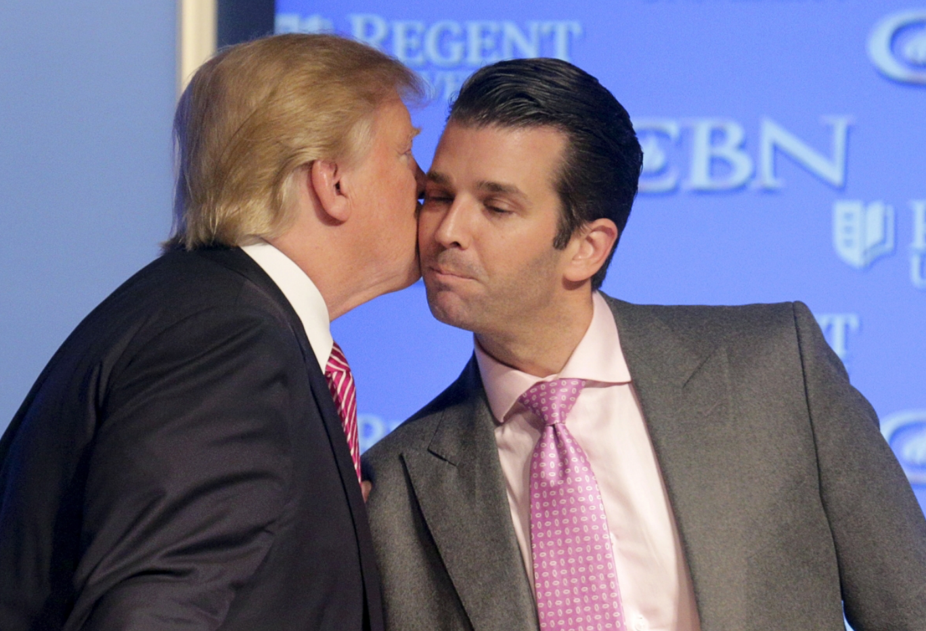
New Dog, Old Tricks?
“Whether Mr Trump wins or loses in November, he now owns the Republicans. They are now prisoners of the Frankenstein they helped to create.”
Edward Luce, Financial Times, 26 August 2020

Slide 18
Disclaimer
The information contained herein has been provided and copyrighted by Alavan Business Advisory Limited which holds all rights pertaining to its distribution and publication. This information shall not be re-produced, published, distributed or replicated in any manner without the prior consent of Alavan Business Advisory Limited.
The information contained herein is designed to be general in nature and is not designed to provide specific advice to a person’s individual circumstance. Persons reading this report should seek professional advice in relation to their individual financial circumstances or investment decisions.
Alavan Business Advisory Limited does not provide any warranty or representation with regards to the accuracy, efficacy, relevance or comprehensiveness of the information contained in this report to any particular person, circumstance or investment choice and shall be absolved of liability for any loss which may arise from the use or misuse of this information.

