Slide 1

ANNUAL GENERAL MEETING 2021
Thursday 9th september 2021

Slide 2
Agenda
Welcome address
Financial Markets Certificate
Activities and achievements of 2020
Overview of the activities of 2021
Financial report and 2021 budget presentation
Report of the statutory Auditors
#LetsMASKItHappen awards
Award of the 15 years membership medals
Election of new Board for the next term
Miscellaneous

Slide 3
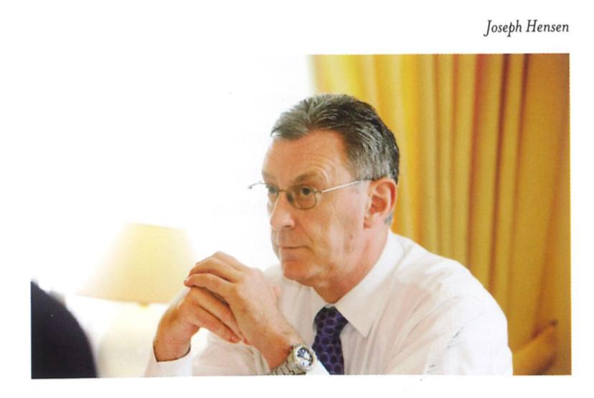
In memoriam...
Josy HENSEN
(16/06/1951 – 08/12/2020)

Slide 4
Agenda
Welcome address
Financial Markets Certificate
Activities and achievements of 2020
Overview of the activities of 2021
Financial report and 2021 budget presentation
Report of the statutory Auditors
#LetsMASKItHappen awards
Award of the 15 years membership medals
Election of new Board for the next term
Miscellaneous

Slide 5
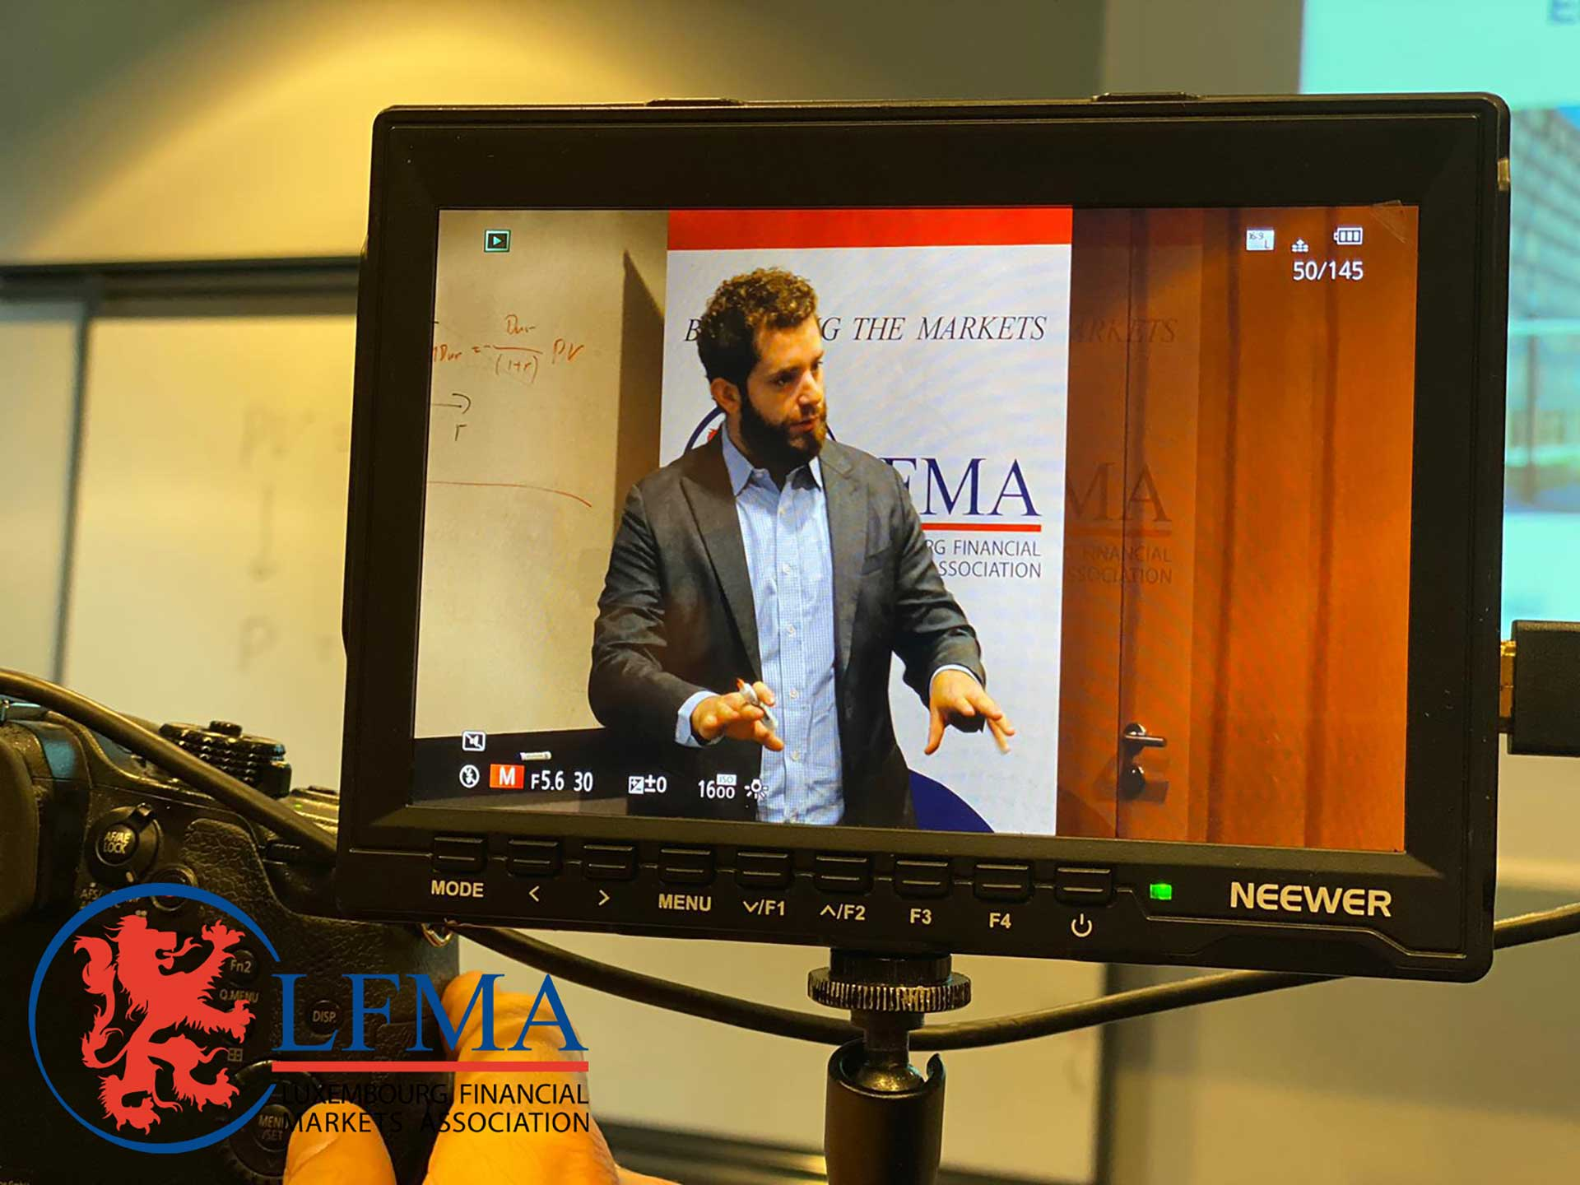
Financial Markets Certificate

Slide 6

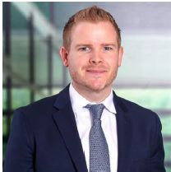
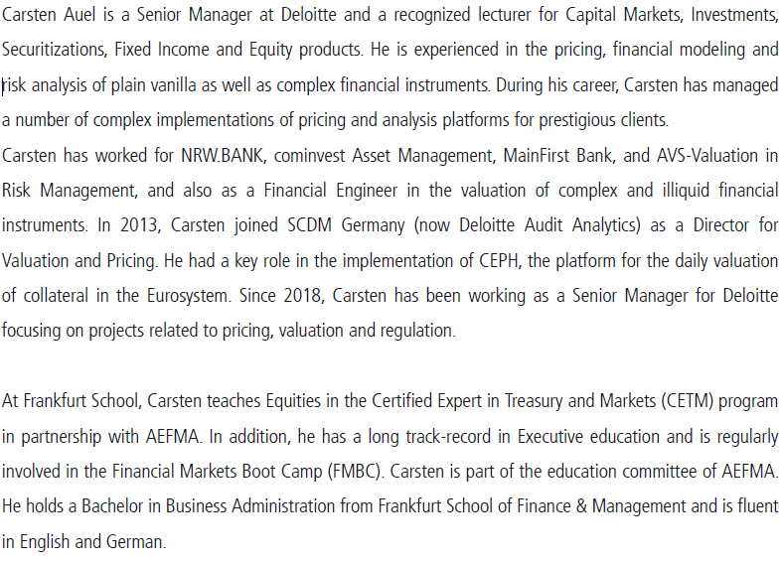
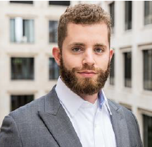
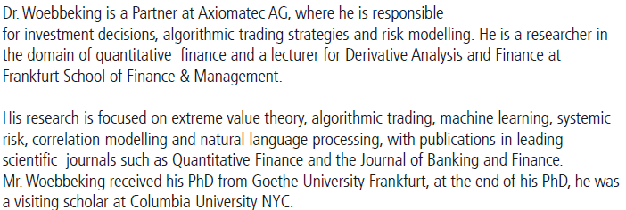

Slide 7
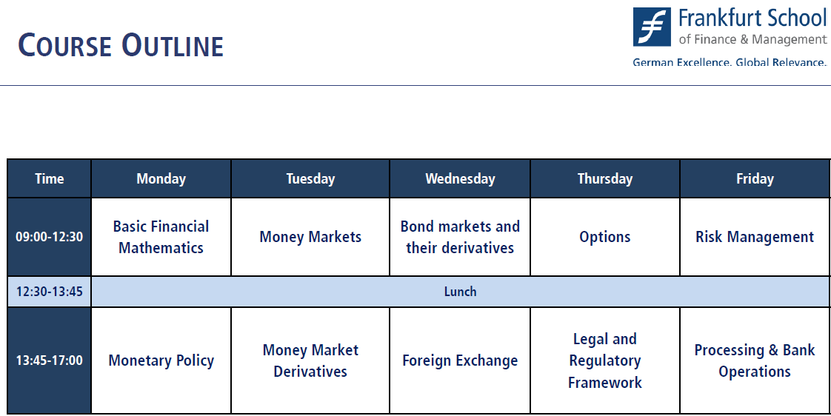

Slide 8
Agenda
Welcome address
Financial Markets Certificate
Activities and achievements of 2020
Overview of the activities of 2021
Financial report and 2021 budget presentation
Report of the statutory Auditors
#LetsMASKItHappen awards
Award of the 15 years membership medals
Election of new Board for the next term
Miscellaneous

Slide 9
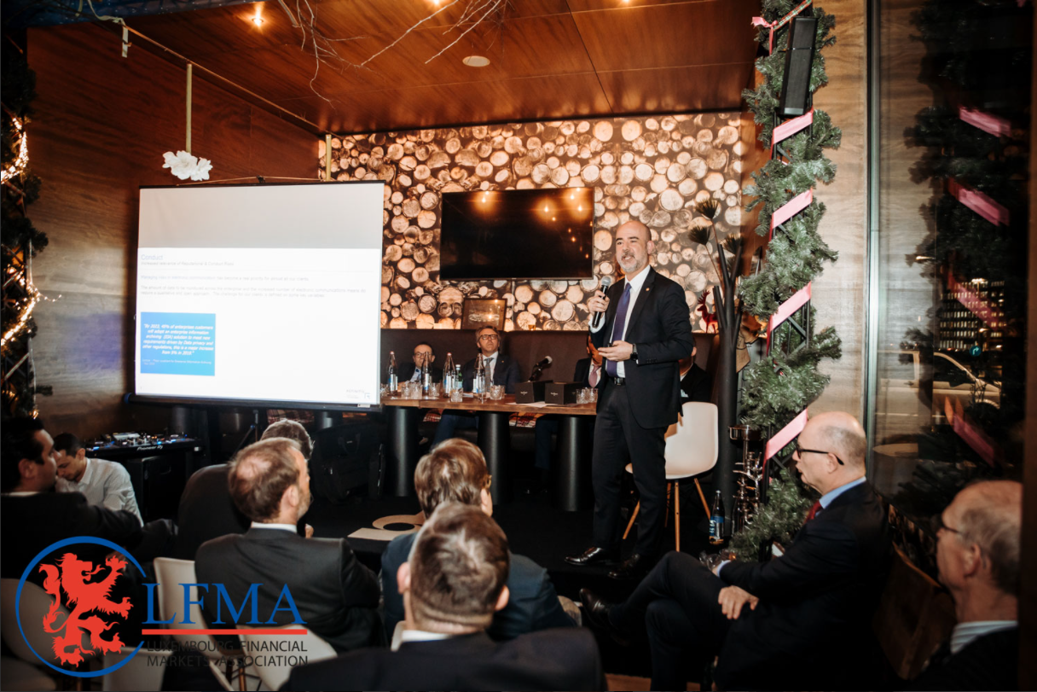
AGM and NYC 2020

Slide 10


Slide 11
Gold’s action during the pandemic
Ms Rhona O’Connell
from historical performances to future implications

Slide 12
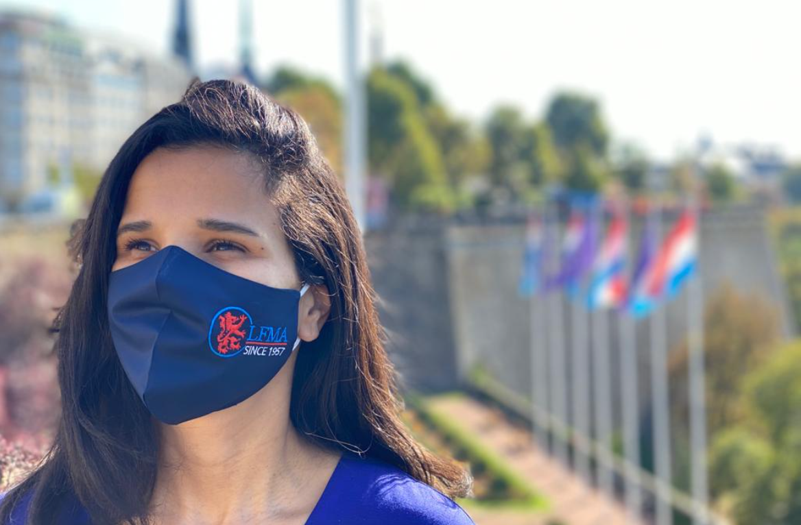

#LetsMASKItHappen

Slide 13
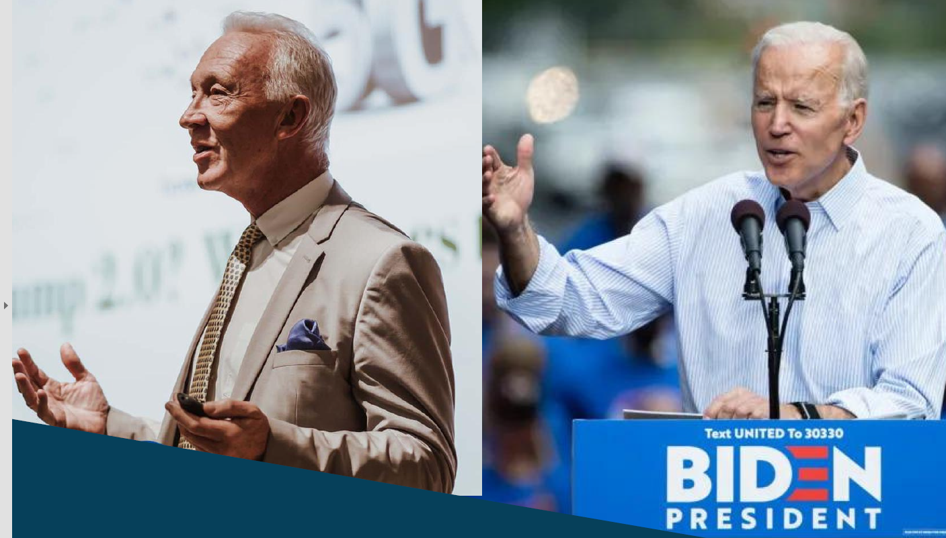
Biden’s America: The End of Trumpism? By Alastair Newton

Slide 14
Agenda
Welcome address
Financial Markets Certificate
Activities and achievements of 2020
Overview of the activities of 2021
Financial report and 2021 budget presentation
Report of the statutory Auditors
#LetsMASKItHappen awards
Award of the 15 years membership medals
Election of new Board for the next term
Miscellaneous

Slide 15
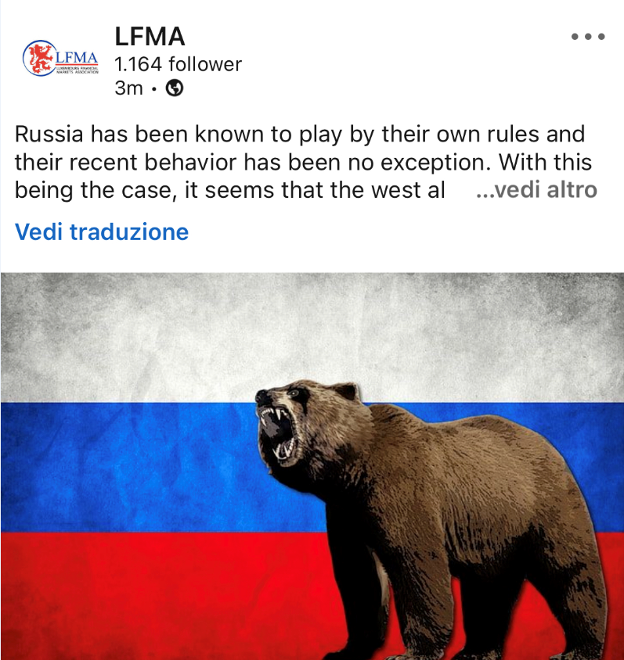
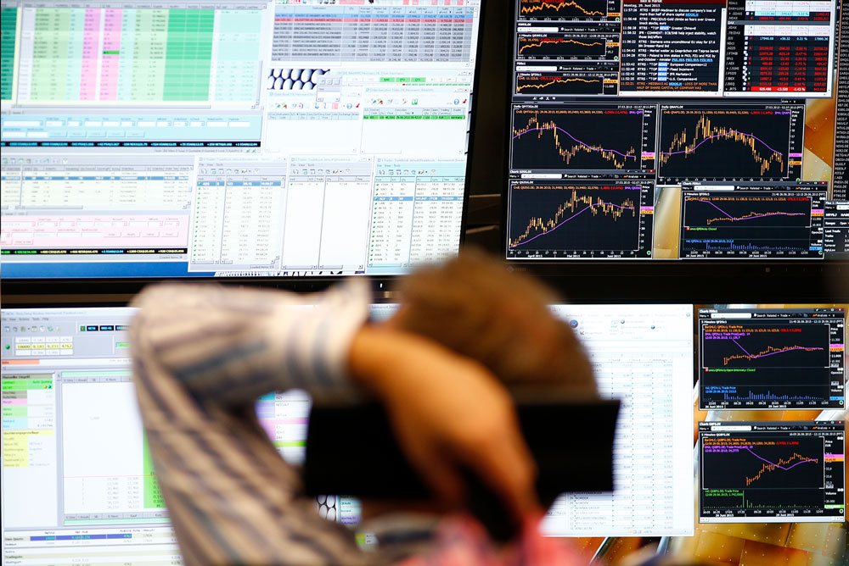
II Series Podcast
II Edition of the
Financial Markets
Certificate

Slide 16
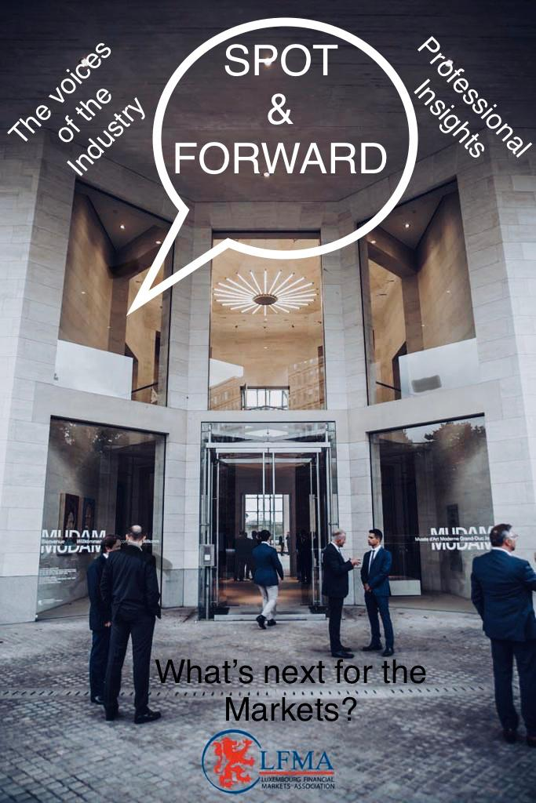
Spot and Forward

Slide 17
Agenda
Welcome address
Financial Markets Certificate
Activities and achievements of 2020
Overview of the activities of 2021
Financial report and 2021 budget presentation
Report of the statutory Auditors
#LetsMASKItHappen awards
Award of the 15 years membership medals
Election of new Board for the next term
Miscellaneous

Slide 18
Balance Sheet as of 31st December 2020
Assets | 2019 | 2020 |  | Liabilities | 2019 | 2020
BCEE Current Account | € 25,297.02 | € 95,757.47 |  | Capital | € 354,254.59 | € 348,044.67
BCEE Savings Account | € 61,815.64 | € - |  | Result | -€ 6,209.92 | € 8,504.81
BDL Savings Account | € 260,932.01 | € 260,792.01
 | € 348,044.67 | € 356,549.48 |  |  | € 348,044.67 | € 356,549.48

Slide 19
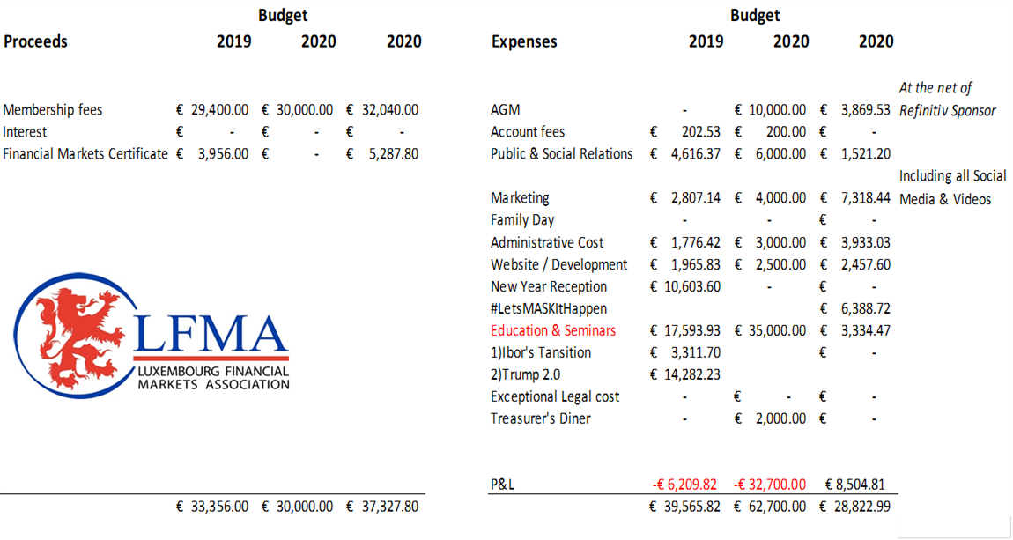
Profit & Loss as of 31st December 2020

Slide 20
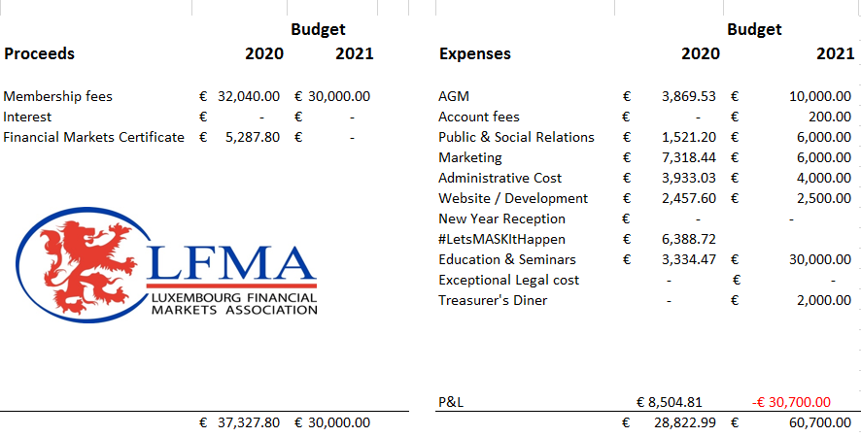
Budget 2021

Slide 21
Report of the statutory Auditors

Slide 22
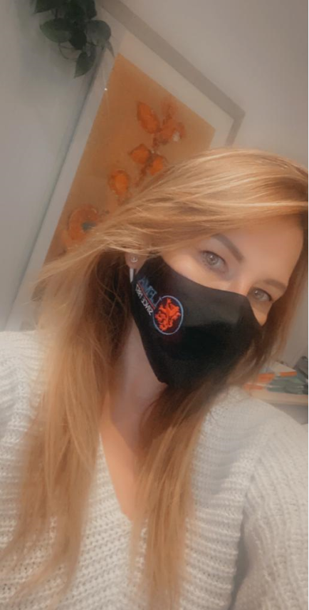
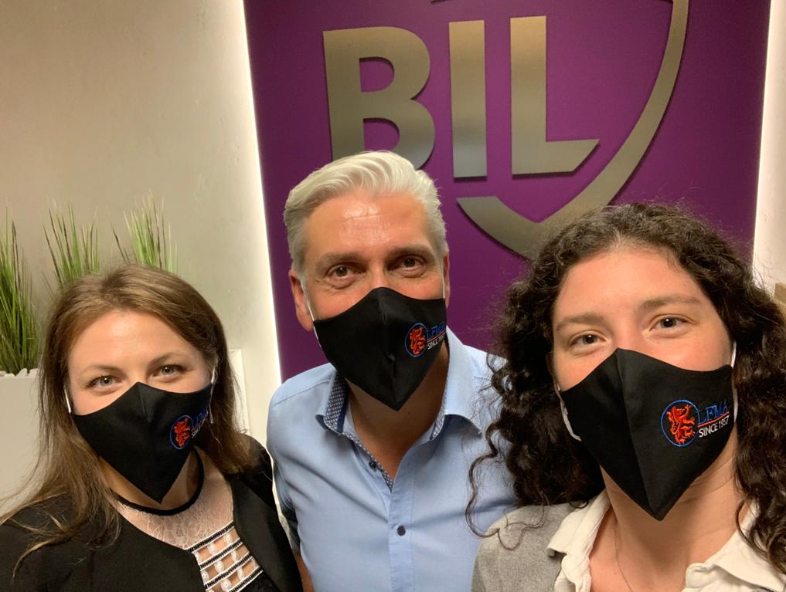

#LetsMASKItHappen Awards

Slide 23
Agenda
Welcome address
Financial Markets Certificate
Activities and achievements of 2020
Overview of the activities of 2021
Financial report and 2021 budget presentation
Report of the statutory Auditors
#LetsMASKItHappen awards
Award of the 15 years membership medals
Election of new Board for the next term
Miscellaneous

Slide 24

15 Years Membership Medals Award
Mr. Maxime Bianconi Caceis Bank Luxembourg
Mr. Vincenzo Ricco Caceis Bank Luxembourg

Slide 25
Agenda
Welcome address
Financial Markets Certificate
Activities and achievements of 2020
Overview of the activities of 2021
Financial report and 2021 budget presentation
Report of the statutory Auditors
#LetsMASKItHappen awards
Award of the 15 years membership medals
Election of new Board for the next term
Miscellaneous

Slide 26
Election of new Board for the next term
Vincenzo Giunta BPER BANK LUXEMBOURG
Larissa Hedlund STONE X
Franck Luxembourger Banque Internationale à Luxembourg (BIL)
Marc Gregoire BANCA ZARATTINI
Antonio Laquintana Fuchs & Associés Finance S.A Luxembourg
Andrea Bauer Commerzbank Finance & Covered Bond SA
Herbert Muck CITI
Ernano Molino FIDEURAM BANK LUXEMBOURG

Slide 27
Agenda
Welcome address
Financial Markets Certificate
Activities and achievements of 2020
Overview of the activities of 2021
Financial report and 2021 budget presentation
Report of the statutory Auditors
#LetsMASKItHappen awards
Award of the 15 years membership medals
Election of new Board for the next term
Miscellaneous

Slide 28


The LIBOR transition enters final stages. Challenges, developments and solutions. Vincenzo Dimase – Global Sales Strategy & Execution Director – Trading at REFINITIV.

